Slide 1




Slide 2

Notes:
4

Slide 3
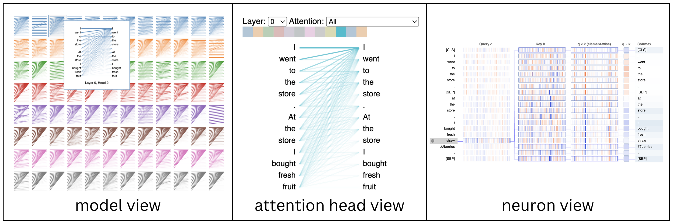

https://www.comet.com/site/blog/explainable-ai-for-transformers/
Transformers
LLMs

Slide 4
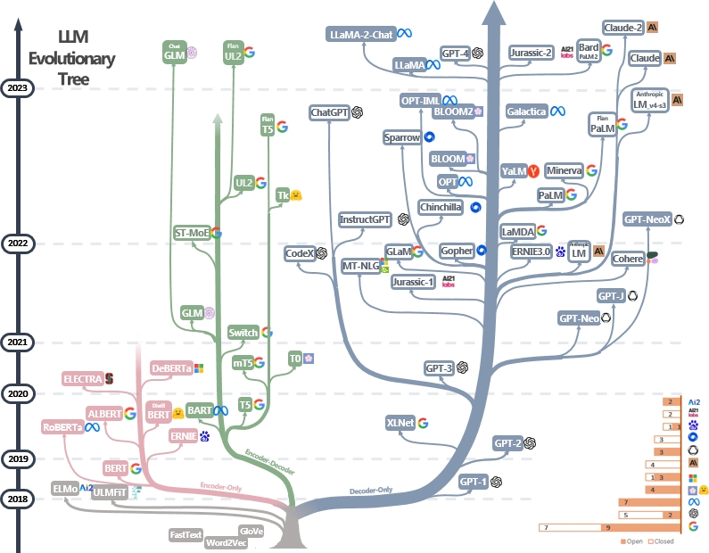
https://github.com/Mooler0410/LLMsPracticalGuide?tab=readme-ov-file
Notes:
Imagine having the power to understand and harness the capabilities of Transformers and large language models,
the revolutionary models that have reshaped the landscape of AI.

Slide 5
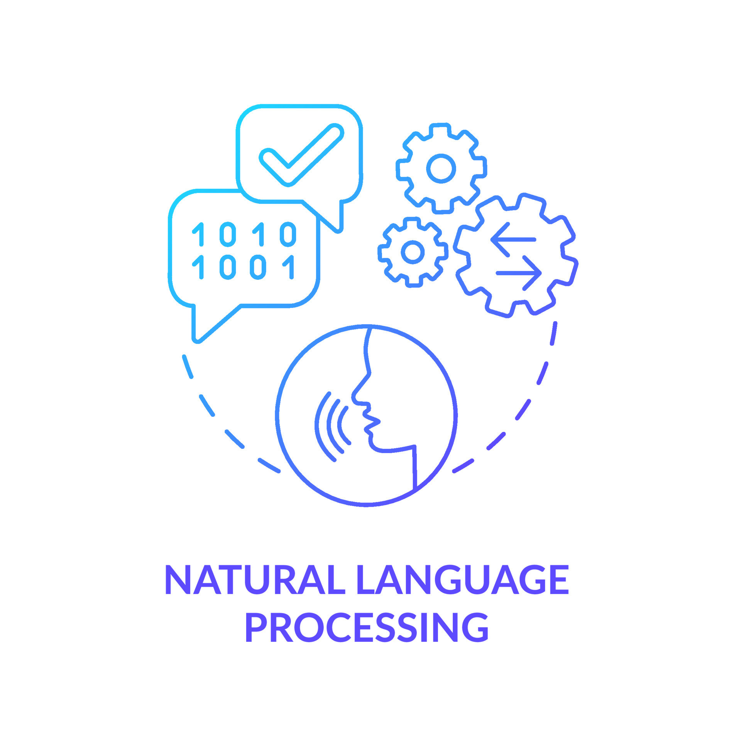
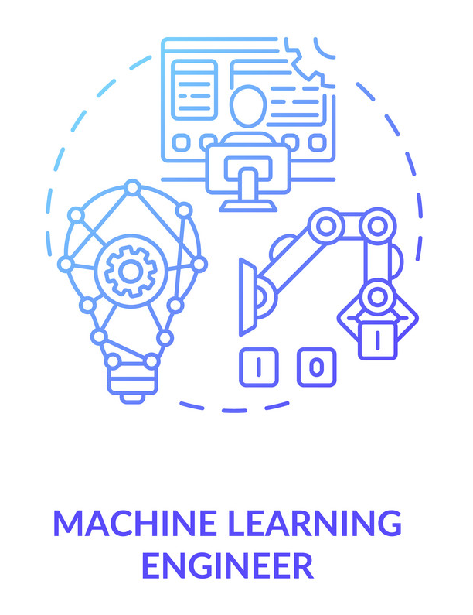





Who this course is for
NLP Enthusiasts
AI Innovators
Notes:
This course is designed for Data Scientists and Machine Learning Engineers.
AI Developers and Programmers.
NLP Enthusiasts.
AI Researchers and Academics.
as well as AI Innovators and Entrepreneurs.

Slide 6
Transformers adventure
LLMs
Deploy LLMs in Production
04
03
Train LLMs from Scratch
Fine Tuning LLMs
02
Understanding Transformers Architectures
01
Notes:
we will take you on an immersive adventure through the Transformers, which are at the heart of large language models.
and break down complex concepts into easily digestible nuggets of knowledge.

Slide 7
Course Prerequisties
Basic Python Programming.
Fundamental Machine Learning Knowledge.
NLP Basics.
Jupyter Notebooks.
Notes:
Before embarking on this journey, ensure you meet the following requirements.
it's essential to have a Basic level of Python Programming,
Fundamental Machine Learning Knowledge,
and it's preferred to have some NLP Basics, also you have to use Jupyter Notebooks.

Slide 8

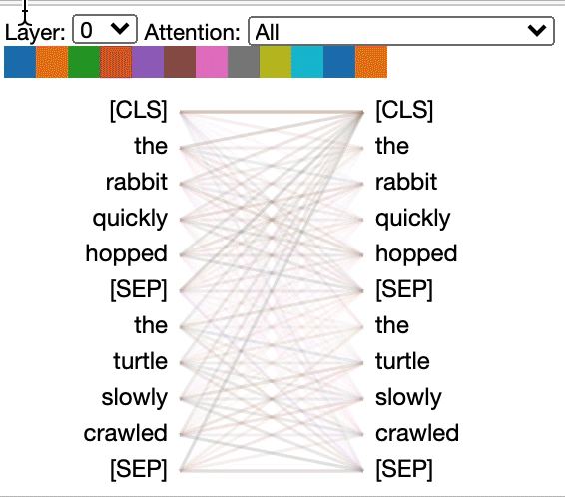
What will we learn?
How Transformers Work → Unravel The Complexities Of Their Internal Structure.
Notes:
in this course You will learn how Transformers work, We will unravel the complexities of their internal structure.
we will delve deep into the mechanics of Transformer layers, demystifying their secrets one layer at a time.
unveiling the mesmerizing magic of the attention mechanism.

Slide 9
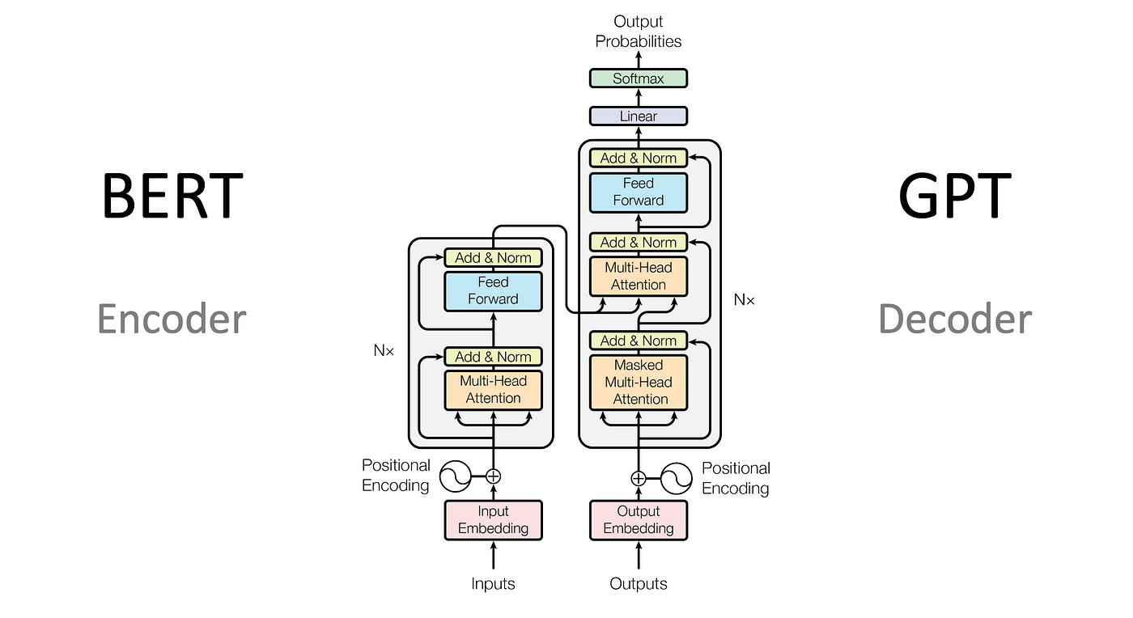
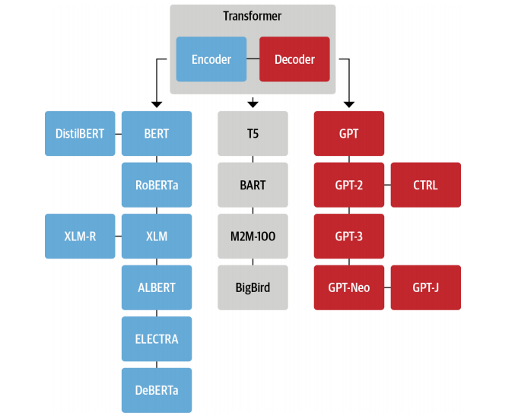
What will we learn?
How Transformers Work → Unravel The Complexities Of Their Internal Structure.
Exploring The Different Transformer Architectures.
T5
(Tunstall, von Werra, & Wolf, 2022, p. 79)
Notes:
But that's just the beginning!
Our course will go the extra mile, By exploring the different Transformer architectures.

Slide 10
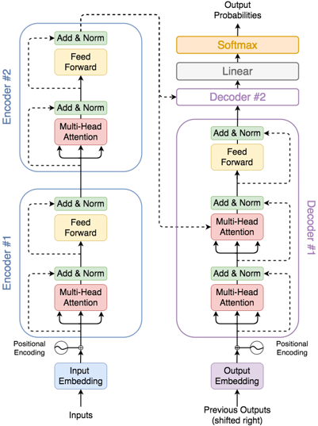

What will we learn?
How Transformers Work → To Unravel The Complexities Of Their Internal Structure.
Exploring The Different Transformer Architectures.
Notes:
You will not only know what makes them unique but also understand how to wield their powers for various tasks.
we will guide you through a comprehensive breakdown of Transformers, Block by block and layer by layer,

Slide 11
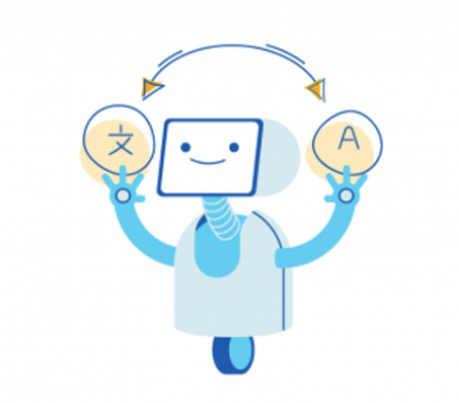
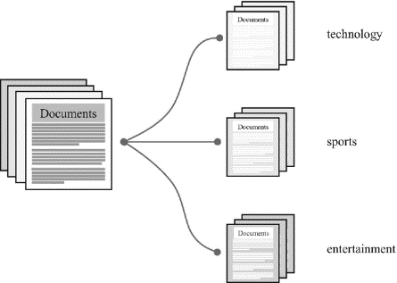
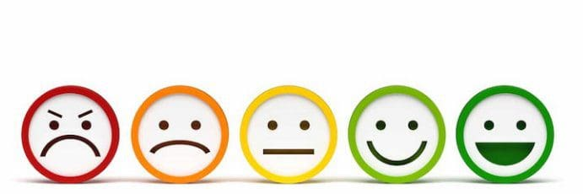


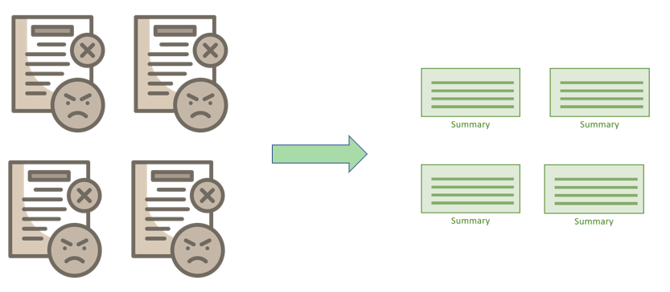
leverage Transformers for a multitude of tasks
Machine Translation
Text Classification
Sentiment Analysis
Question Answering
Text Generation
Text Summarization
Notes:
The excitement doesn't stop there!
You will Discover how to leverage pre-trained Transformers for a multitude of tasks.
from machine translation to the precision of text classification.
You'll master sentiment analysis. question answering. text generation. and text summarization, opening up
a world of possibilities.

Slide 12


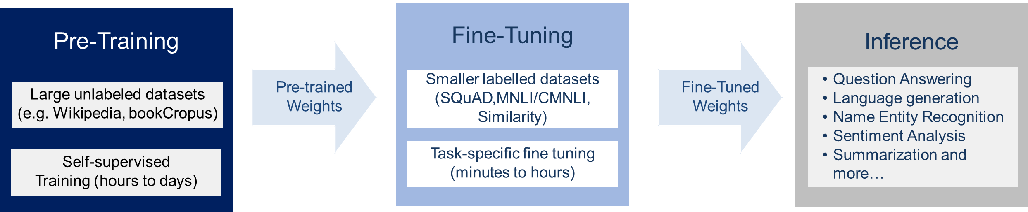
What will we learn?
How Transformers Work → To Unravel The Complexities Of Their Internal Structure.
Exploring The Different Transformer Architectures.
How To Leverage Pre-trained Transformers For A Multitude Of Tasks.
Fine-tuning A Transformer For Your Specific Needs.
Notes:
But that's not all!
We will equip you with the knowledge to fine-tune a Transformer for your specific needs using your own dataset.

Slide 13
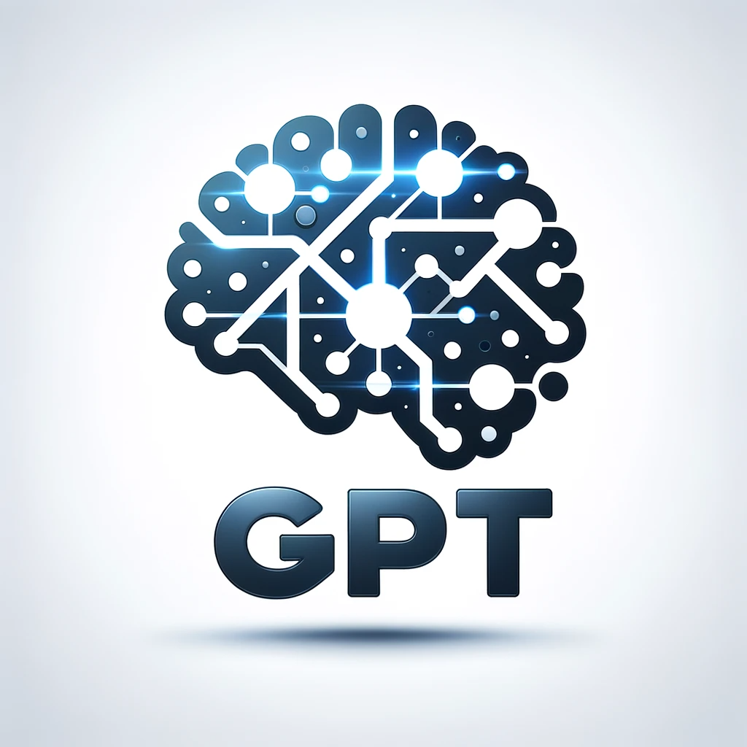
What will we learn?
How Transformers Work → To Unravel The Complexities Of Their Internal Structure.
Exploring The Different Transformer Architectures.
How To Leverage Pre-trained Transformers For A Multitude Of Tasks.
Fine-tuning A Transformer For Your Specific Needs.
How To Train Your Own GPT Model.
Notes:
also, You'll learn how to train your own GPT model.

Slide 14
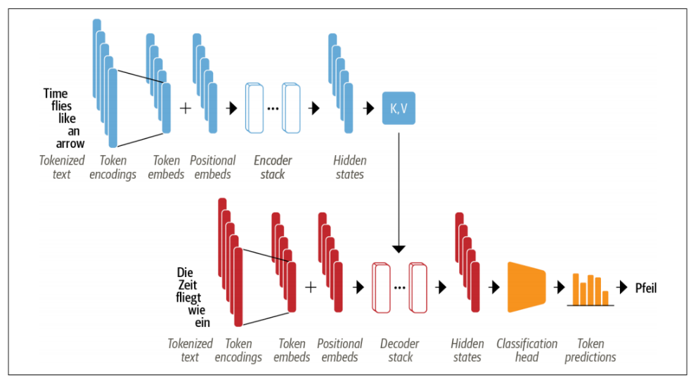
What will we learn?
How Transformers Work → To Unravel The Complexities Of Their Internal Structure.
Exploring The Different Transformer Architectures.
How To Leverage Pre-trained Transformers For A Multitude Of Tasks.
Fine-tuning A Transformer For Your Specific Needs.
How To Train Your Own GPT Model.
How To Build And Train Your Own Transformer Model From Scratch.
Transformers
are
+
K,V
…
great
Token Embeddings
Positional Encoding
Encoding stack
Hidden state
Transformers
+
…
super
est
Figure adapted from Tunstall, von Werra, & Wolf, 2022, p. 58
Classification
head
Token Prediction
Token Embeddings
Positional Encoding
Decoder stack
Hidden state
Notes:
and even build and train your own Transformer model from scratch.
You'll be the architect of AI innovation!

Slide 15

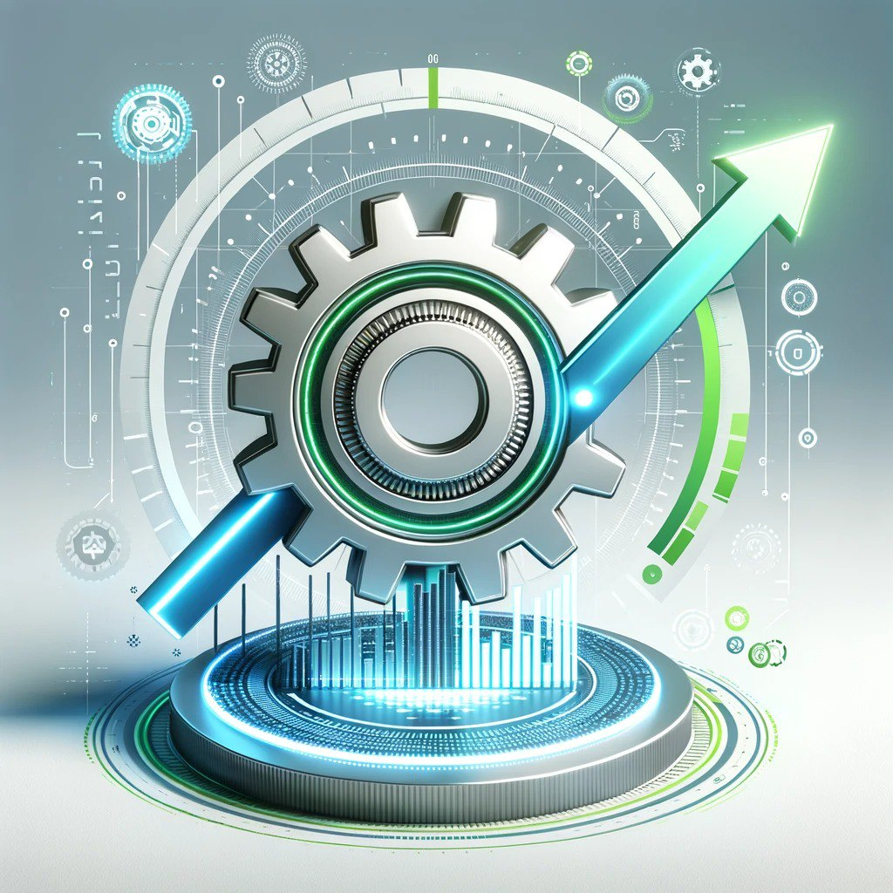
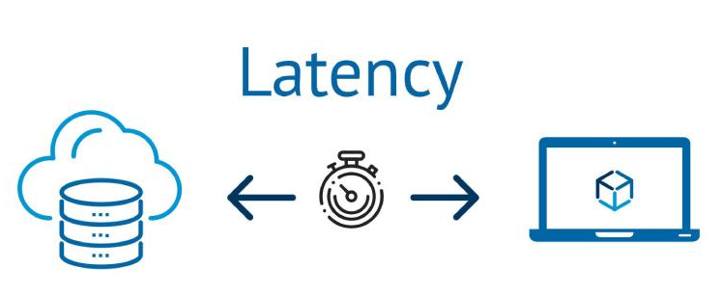
What will we learn?
How Transformers Work → To Unravel The Complexities Of Their Internal Structure.
Exploring The Different Transformer Architectures.
How To Leverage Pre-trained Transformers For A Multitude Of Tasks.
Fine-tuning A Transformer For Your Specific Needs.
How To Train Your Own GPT Model.
How To Build And Train Your Own Transformer Model From Scratch.
Transformer Models Optimization.
Transformers
Notes:
But wait, there's more!
Optimization is the name of the game. We'll show you how to streamline your language model for low latency and seamless deployment.

Slide 16
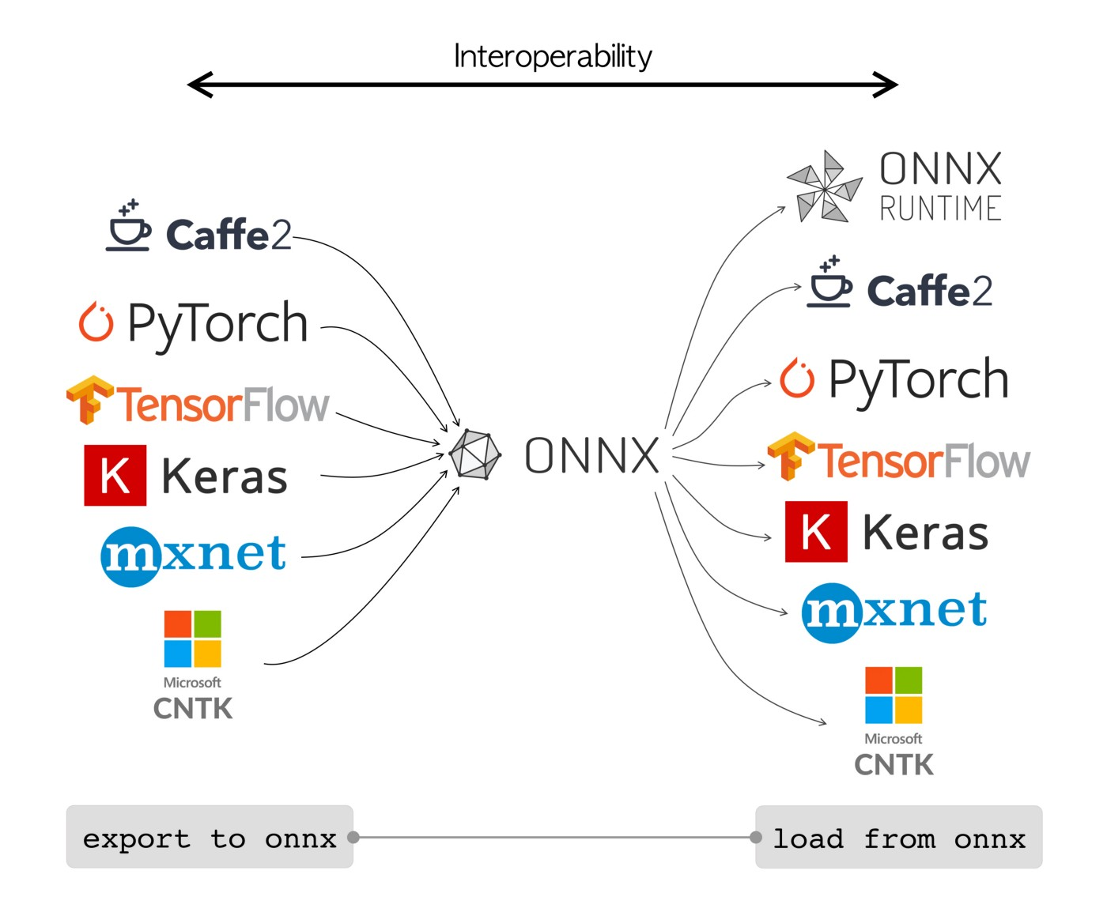
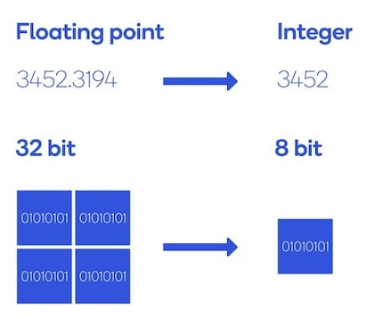
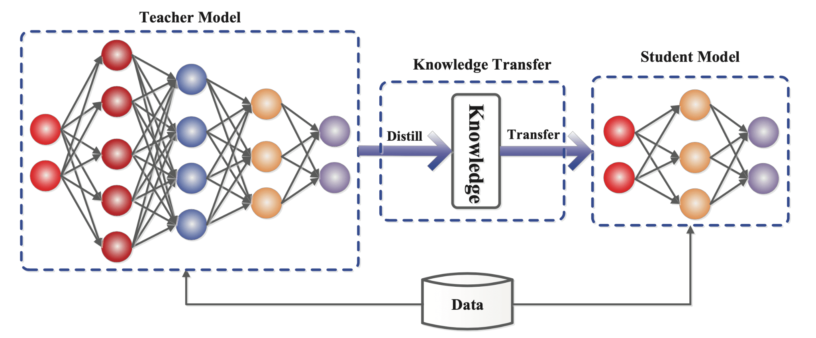
What will we learn?
How Transformers Work → To Unravel The Complexities Of Their Internal Structure.
Exploring The Different Transformer Architectures.
How To Leverage Pre-trained Transformers For A Multitude Of Tasks.
Fine-tuning A Transformer For Your Specific Needs.
How To Train Your Own GPT Model.
How To Build And Train Your Own Transformer Model From Scratch.
Transformer Models Optimization.
Transformers
Quantization
Knowledge Distillation
ONNX
Notes:
Discover the art of quantization, master the complexities of Knowledge Distillation, and navigate the world
of ONNX runtime. And when it's time to share your masterpiece with the world, we've got you covered!

Slide 17


What will we learn?
How Transformers Work → To Unravel The Complexities Of Their Internal Structure.
Exploring The Different Transformer Architectures.
How To Leverage Pre-trained Transformers For A Multitude Of Tasks.
Fine-tuning A Transformer For Your Specific Needs.
How To Train Your Own GPT Model.
How To Build And Train Your Own Transformer Model From Scratch.
Transformer Models Optimization.
Transformer Models Deployment.
Transformers
Notes:
Learn the basics of serving your Transformer model in a production environment using Docker and FastAPI.
Deploying large language models in production environments will become second nature to you.

Slide 18
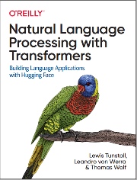
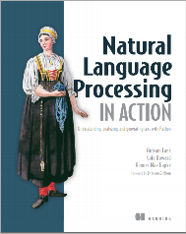
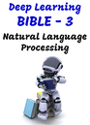
Course Reference
Notes:
We drew inspiration from the following sources when developing the content for this course.
Natural Language Processing with Transformers.
Natural Language Processing in Action.
Deep Learning Bible for Natural Language Processing, The English version.
And The Hugging Face website.
Are you ready to embark on this thrilling AI adventure?
Buckle up, because the journey to Transformer mastery starts now!

Slide 19
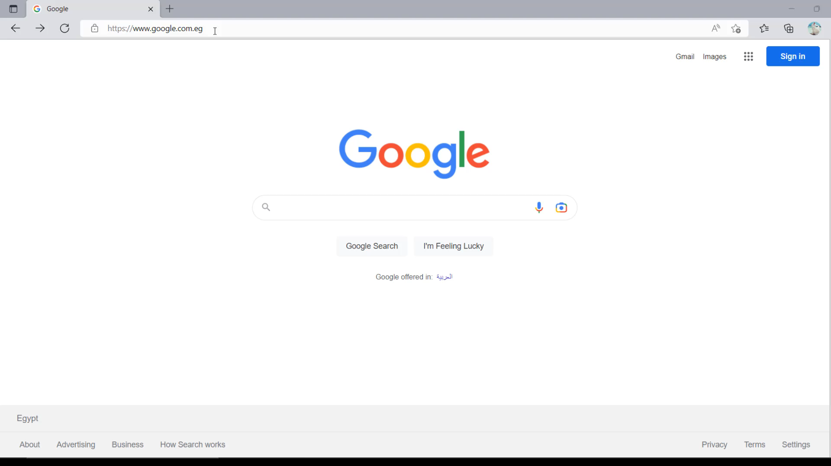
Notes:
We drew inspiration from the following sources when developing the content for this course.
Natural Language Processing with Transformers.
Natural Language Processing in Action.
Deep Learning Bible for Natural Language Processing, The English version.
And The Hugging Face website.
Are you ready to embark on this thrilling AI adventure?
Buckle up, because the journey to Transformer mastery starts now!

Slide 20



